Slide 1
DEV OPS v1.4.6
5/24/2018
Notes:
This slide deck is to help in the understanding of DevOps in relation to Thingworx Foundation platform
Jira link https://ssp.ptc.com/jira/browse/CSPORTDEV-1921

Slide 2
The overlap and combination
Operations
Development
DevOps

Slide 3
DEV OPS
DevOps can be defined as the end to end software delivery lifecycle.
Depending on your environment and tools approaches will be different.
The goal is to provide a predictive and agile methodology that results in a process based on requirements and desired outcome.
The creative outcome from Development will need propagation from incubation to Test (more controlled), then onto QA (Acceptance - works as defined) and finally Production (Real time usage).
The following provides an overview of the “Informed Practice” techniques used when developing inside ThingWorx.
Notes:
https://en.wikipedia.org/wiki/DevOps

Slide 4
ACTIONABLE ITEMS
Notes:
This slide deck is to help in the understanding of DevOps in relation to Thingworx Foundation platform
Jira link https://ssp.ptc.com/jira/browse/CSPORTDEV-1921

Slide 5
ACTIONABLE ITEMS
Set up a DEFINED PROCESS (Based on on what is presented on the coming slides)
Establish naming rules that help to categorize development.
Understand Security and Organization and how to implement inside Thingworx. Implement with both in mind as development progresses.
Setup Multiple environments. (On premise or Cloud)
Development
Sandbox
Test
QA
Production
Management of Environment (Thingworx Versions and Extensions Versions must be in sync across environments)
Understand that Development is shared across systems using Export/Import processes
(discussed in more detail)
Question: Are there already Software version control system in place? : SVN or GIT to capture history of development. If yes explore and develop an approach.
Notes:
The considerations are a blueprint to getting started – each customer part may have slightly different processes but the general contet should be adhered to.

Slide 6
BEFORE Development Starts
Notes:
This slide deck is to help in the understanding of DevOps in relation to Thingworx Foundation platform
Jira link https://ssp.ptc.com/jira/browse/CSPORTDEV-1921

Slide 7

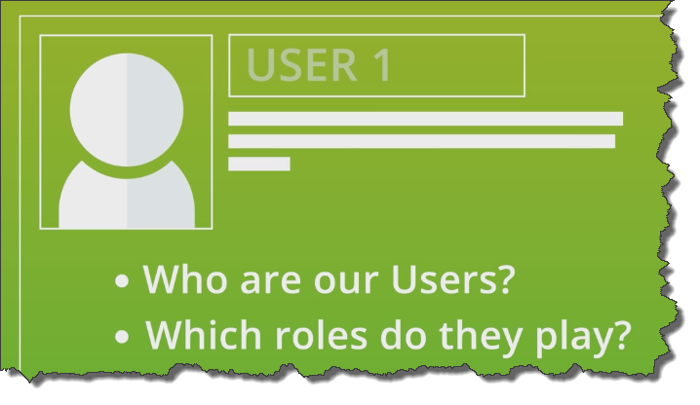
THINK WHO ARE THE USERS and what roles they play
BEFORE and during Coding
Notes:
The idea behind this is to Think security and visibility

Slide 8

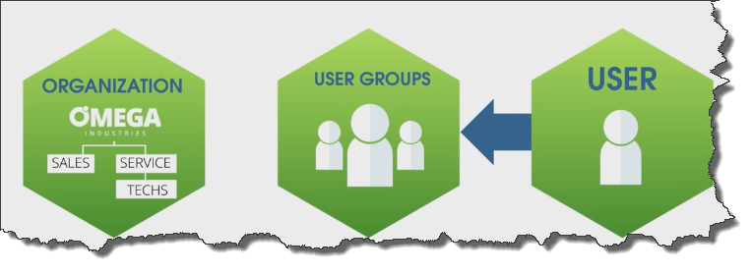
USER ACCESS FRAMEWORK - RECAP
Highest level who
A set of users who have access
Groups collect user
Unforce access control at Group
Organizational units define visibility
SALES
SERVICE
TECHS

Slide 9
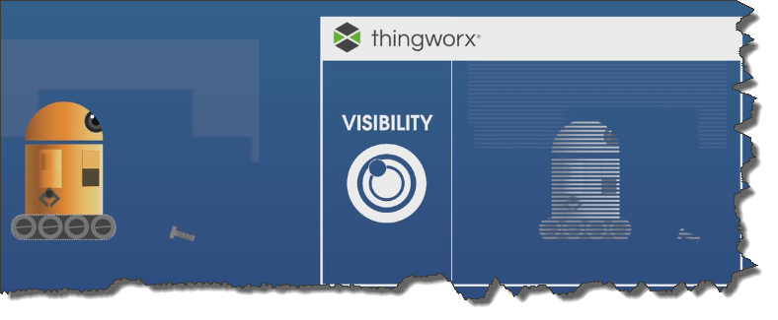
Understand Visibility
Visibility
If you don’t have visibility you can’t see anything

Slide 10
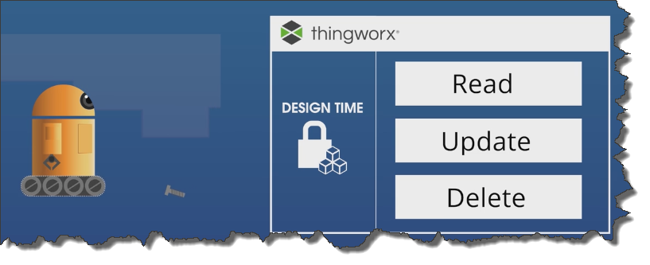
Make sure you Understand development SECURITY
Design Time
Inside Composer
or
Designing Model
Thing or Collection level assignment

Slide 11
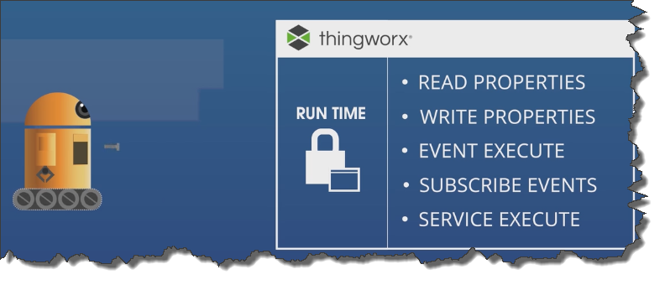
Make sure you Understand runtime SECURITY
Run Time
Inside Mashups
Notes:
Runtime is the permission that allows users to execute services that request information

Slide 12
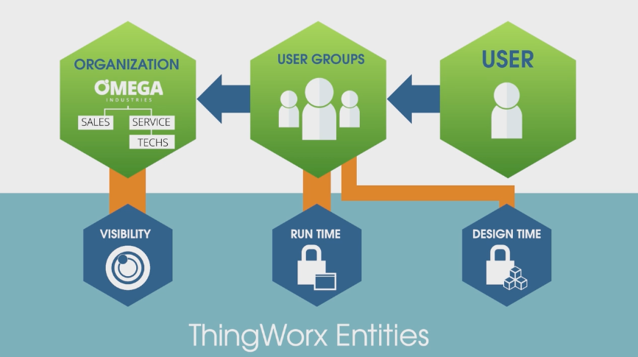
USER ACCESS FRAMEWORK
Users needs Visibility and Run Time to do anything
Developers needs Visibility and Design Time to model

Slide 13
Additional areas to keep in mind
Notes:
This slide deck is to help in the understanding of DevOps in relation to Thingworx Foundation platform
Jira link https://ssp.ptc.com/jira/browse/CSPORTDEV-1921

Slide 14
ADDITIONAL AREAS TO KEEP in MIND as development progresses
THINK BRANDING/STYLING INPUT FROM THE START
If Extensions are used make sure version are consistent
Notes:
This slide is there to remind us that Branding should be considered up front. Plus making sure that some kind of acceptance criteria is put in place. Also any existing dependent extension need to be located

Slide 15
Work breakdown
Notes:
This slide deck is to help in the understanding of DevOps in relation to Thingworx Foundation platform
Jira link https://ssp.ptc.com/jira/browse/CSPORTDEV-1921

Slide 16
WORK Breakdown
Break work down into Areas that can be managed as a single unit
Mashup
Services
Entities
Define a Project and place all new work into the same project
Add dependent common project that contains State definitions, Styles and Media
This approach allows for easy export based on Project
Consider using a Helper service Thing per mashup
This helps in creating a complete package per Mashup
Notes:
Work breakdown is different for Thingworx a developer often does all aspects of development not just front or backup or UI

Slide 17
Acceptance AND testing
Notes:
This slide deck is to help in the understanding of DevOps in relation to Thingworx Foundation platform
Jira link https://ssp.ptc.com/jira/browse/CSPORTDEV-1921

Slide 18
ACCEPTANCE CRITERIA and TESTING
All Design implementations should have
Design Specification
Acceptance criteria
Test procedure to valid Design
Why? - To validate Implementations are working as expected based on Acceptance criteria
All development design should have Test Mashups that can be used to validate data
The mashups should be created as the design progresses
These Mashup are not intended for User usage
They are as a way to document and help testers understand the Data Structures
Notes:
All designs and development need acceptance criteria to make sure both Design and development are in line. Over time different people work on the project and knowledge of “the why” can be lost.

Slide 19
Naming and scripting
Notes:
This slide deck is to help in the understanding of DevOps in relation to Thingworx Foundation platform
Jira link https://ssp.ptc.com/jira/browse/CSPORTDEV-1921

Slide 20
NAMING Approach
ThingWorx is a rapid application environment and if not managed correctly can become unstructured quickly
Start with Structured naming - Use Pre fixes and Suffixes like Functionality and Type
AssetMgr-MU
AssetMgr-DS
AssetMgr-TT
Use a TAG as the Overal key
Provider PTC
Application ServicePlan
Use a Project to collect Entitles
AssetMgr-PJ
Use a Common Project to collect Entitles that span projects
Common-Types
When creating projects remember the dependent projects option
use as required.
Notes:
Naming is very key, without that its difficult to find things quickly

Slide 21
SOME NAMINg CONVENTIONS EXAMPLE
Entity Name | Naming Convention
Mashup | PRODUCT-MU/POP
Master | PRODUCT-Master
Gadget | PRODUCT-Gadget
Dashboard | PRODUCT-Dashboard
Menus | PRODUCT-Menu
Sub Menu | PRODUCT-SMenu
Media | PRODUCT-Media
Style Definitions | PRODUCT-Style
State Definitions | PRODUCT-State
Data Tables | PRODUCT-DT
Data Shapes | PRODUCT-DS
Streams | PRODUCT-Streams
Value Streams | PRODUCT-VS
Blog | PRODUCT-Blog
Wiki | PRODUCT-Wiki
Application Keys | PRODUCT-APPKEY
Things | Serial Number
Things (Services) | PRODUCT-Helper
Thing Template | PRODUCT-TT
ThingShape | PRODUCT-TS
Note: * represents the name of the Entity and should be in Camel Case
If there is common functionality, that can be shared among multiple entities, GEN.Common.* should be used.
If an entity is created for TEST purposes. Name the entity with TEST*.Entity Extension (* represents logical name of the entity in Camel Case. Entity Extension is the blue text highlighted above)
Notes:
Examples help but customer or partner may have there own approach

Slide 22
Script EXAMPLE Coding Standards - Services
Service name should be pre-fixed with a “Verb” plus description of the service. Few examples of the verb are
Get: If the service is retrieving a single value from any Database
Set: If the service is trying to update a single Database Entity
Query: If the service is returning a group of records from Database Entity
Add: If the service is adding a record to a Database Entity
Update: If the service is updating a record to a Database Entity
Delete: If the service is Deleting a record
Validate: If the service is created to validate the records
Purge: If the service is created to purge the records
Create: If the service is used to create a set of records
Import: If the service is created to import the data
Export: If the service is created to Export the data
Parse: Service created to parse the data
Name of the service should be logical.
Common services should be grouped in a common thing
Notes:
Standards help to provide consistency and adoption at the start. This is key to a successful deployment

Slide 23
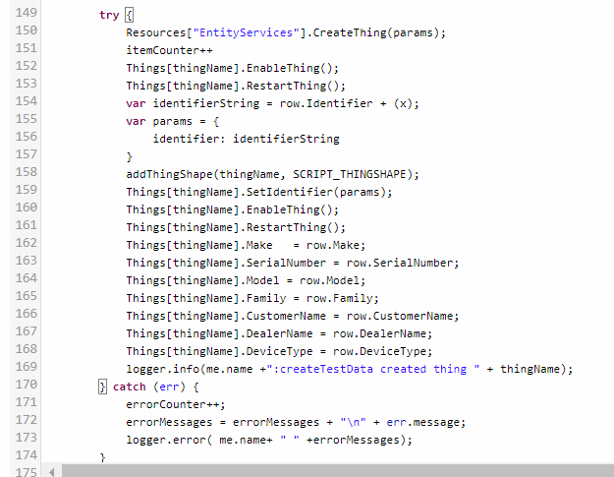
Script EXAMPLE Coding Standards
Creation History: Should be documented. Should contain
Revision History statements help
Any commented code should be removed.
Comments should be added where it makes sense
Variable name declaration at the top can be helpful.
Variable names should be consistent
Exception Handling should be incorporated whenever a piece of logic is trying to do something complex and requires an outcome.
Any errors should be logged

Slide 24
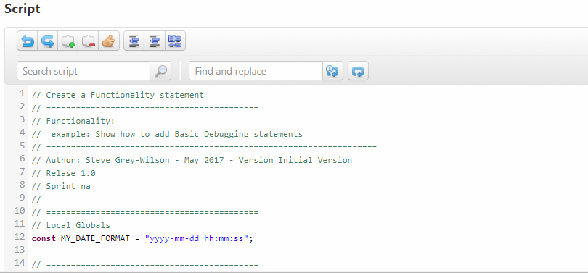
Script EXAMPLE Coding Standards – INITIAL Creation
Should be documented. Should contain
Functionality of Service
Author
Date followed by “initial Version”
Release
Sprint
Notes:
Basic best practice example – This can be changed if needed

Slide 25
Landscape and Flow of Changes
Notes:
This slide deck is to help in the understanding of DevOps in relation to Thingworx Foundation platform
Jira link https://ssp.ptc.com/jira/browse/CSPORTDEV-1921

Slide 26
FROM DEVELOPMENT to production
The process of moving from Development to Production is not the same a using build tools.
ThingWorx is a multiple user rapid development environment and uses Projects, TAGS and Export to moving development from one system to another.
Overtime Production grows and rapid incremental changes can be handled using Import
Before any imports can be moved to Production exports need to be verified first in a TEST System then on QA System
TEST is used to get a first pass feel for the new development
QA is used as an acceptance environment making sure the Export is valid and the design reflects the requirements.
Note: the QA should be a replication of production. It may not have the complete set of Data or may have a set of data that is valid based on data security. The idea is to exercise the new design feature in an environment that is close to production as possible.
Notes:
Exporting and Importing are currently the core methods to moving development work to TEST, QA and Production

Slide 27
LANDSCAPE AND flow of changes
Design Time Permissions
Design Time Permissions
Open
Closed
Development
Export
TEST
QA
PRODUCTION
Export
Based on
Initial Setup?
Project?
Bug fix-Tag?
Initialized from a Base point
Initialized from a Base point
Export real data as needed
Import
Import based on Passed tests results
Users
Groups
Organizations
Extensions
Entities
Model Tags
States/Styles/Media/Menus/LocalizationTables
PersistenceProviders/PersistenceProviderPackages
DataShapes
ThingShapes
ThingTemplates
Things(Subset)
Mashups
Projects
Subsystems
Snapshot before any updates
Export
Import based on Passed QA acceptance criteria
Notes:
Thingworx uses Export and import as it core flow process from one system to another.
This is not to be confused with Backup and Restore (A production server will have Database back and restore as its prime backup process)

Slide 28
Export and import
Notes:
This slide deck is to help in the understanding of DevOps in relation to Thingworx Foundation platform
Jira link https://ssp.ptc.com/jira/browse/CSPORTDEV-1921

Slide 29
TYPEs OF EXPORT
Where?
Local export as XML or bin format
Server side export all including Data
What?
Entities (Definitions of the entity for example users,groups,DataShapes,ThingTemplates)
Data (Data related to Streams or DataTables)
How?
Import/Export menu or More for singular Entity exporting (source control and Version history)
Who?
Generally Administrators are the only users that can import or export.
Notes:
Make sure the team understands Export and Import

Slide 30
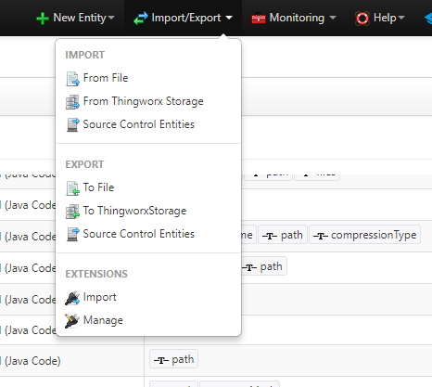
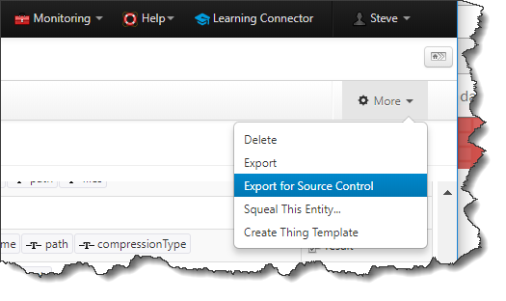
WHERE Export ACTIONS CAN be found
To File (Provides granular exporting in a single file)
Entities - Client Side
Data – Server Side
To ThingworxStorage (all entitles with/without Data)
Source Control Entities (Provides granular exporting – in multiple files – Server Side save or singular client side)
Entities – Server Side
Data – Server Side
The multiple aspect makes it useful when checking into an SVN history tool
Notes:
Export can be Client side and Server Side – Client side is used when pulling a developers changes locally for checkin to a SVN (software version control) explained later
Exporting server side is an old backup approach for using with H2 – It can be useful as a start point to SVN structure

Slide 31
Exporting FOR SOURCE CONTROL
Use the Entity Export for Source Control for individual Entities check-in
This provides a more structured output
Notes:
Client side export can be used in a SVN checkin process – Many customers and partners use GIT – The same process applies to both export xml move to repo and checkin xml

Slide 32
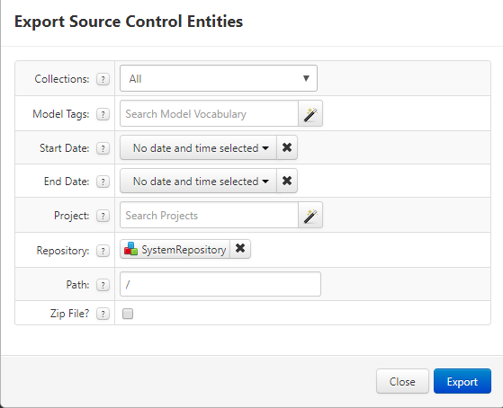
Exporting FOR SOURCE CONTROL
Use the EXPORT-> TO THINGWORX STORAGE (Server side Export) to get the source control initial structure.

Slide 33
Base initialization from export
Notes:
This slide deck is to help in the understanding of DevOps in relation to Thingworx Foundation platform
Jira link https://ssp.ptc.com/jira/browse/CSPORTDEV-1921

Slide 34
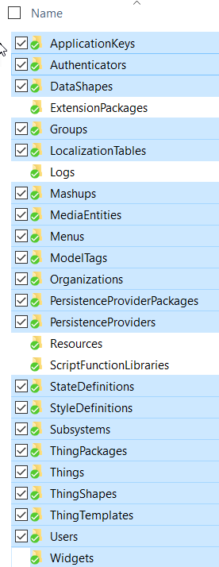
Export STRATEGY for initialization of another system based on development or another system
Use Export Source Control Entities All
Then pick and choose which to use to initialize another system
The order is important
Trying to do all at once often fails due to dependencies. There can be times when you will have to export/import an individual Entity due to import order
Import order
Uses,Groups and Organizations
Extensions
PersistenceProviders, PersistencePackages
LocalizationTables, ModelTags
MediaEnties,StateDefinitions,StyleDefinitions
ApplicationKeys,Authenticators
DataShapes
ThingShapes
ThingTemplates
Subsystems
Things
Development
Export
Based on
Initial Setup?
Project?
Bug fix-Tag?
Export
Notes:
Export should only export development created Entities

Slide 35
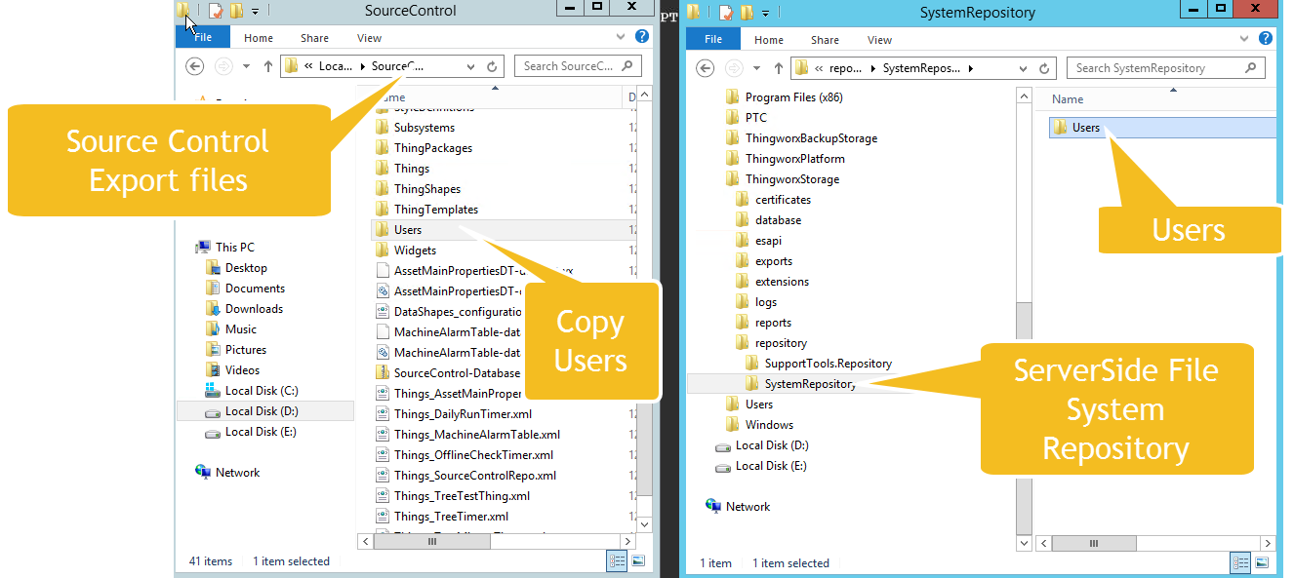
COPY EXPORTED USERS to Server-side repository PART1
TEST
Initialized from a Base point
Notes:
If not using Ldap or external users definition. Use export uses to get users from on system to another

Slide 36
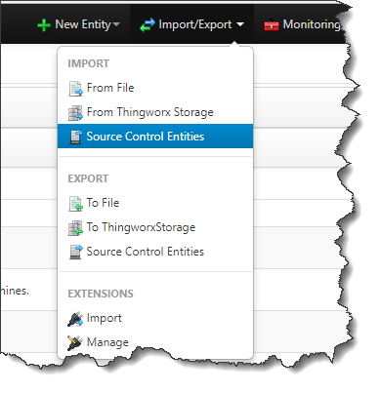
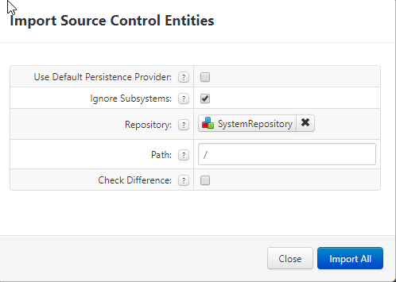
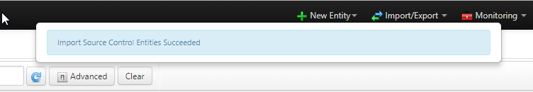
IMPORT USERS FROM Server-side repository
TEST
Initialized from a Base point

Slide 37
REPEAT Import FOR other Entity folders
After each import make sure it completes successfully
Groups and Organizations
Extensions
PersistenceProviders, PersistencePackages
LocalizationTables, ModelTags
MediaEnties,StateDefinitions,StyleDefinitions
ApplicationKeys,Authenticators
DataShapes
ThingShapes
ThingTemplates
Subsystems
Things
Note: A large number of Things can take a while to import

Slide 38
Collection level permissions
Notes:
This slide deck is to help in the understanding of DevOps in relation to Thingworx Foundation platform
Jira link https://ssp.ptc.com/jira/browse/CSPORTDEV-1921

Slide 39
Collection level permissions
When Exporting using Source Control Entities Collection level permission are not exported – This only happens with Export to ThingWorx Storage.(Which is really a backup of all things )
There is a Resource Entity called CollectionFunctions, that provides two services
ExportUserPermissions
ImportUserPermissions
This will allow exporting of collection level permissions and re-importing.
Notes:
Collection Level premissions do not come with exports. Run the 2 services to get the collection level permissions and import to TEST, QA and Production.

Slide 40
Add SYSTEm USER to all collectionS example
var params = {
modelTags: undefined /* TAGS */,
type: undefined /* STRING */
};
// result: INFOTABLE dataShape: EntityCount
var EntityTypeList = Subsystems["PlatformSubsystem"].GetEntityCount(params);
for each (var row in EntityTypeList.rows) {
try {
var params = {
principal: "System" /* STRING */,
allow: true /* BOOLEAN */,
resource: "*" /* STRING */,
type: "ServiceInvoke" /* STRING */,
principalType: "User" /* STRING */,
collectionName: row.name /* STRING */
};
// no return
Resources["CollectionFunctions"].AddCollectionRunTimePermission(params);
}
catch(err) {
}
}
Notes:
Useful script to be run on servers after import

Slide 41
Population of data
Notes:
This slide deck is to help in the understanding of DevOps in relation to Thingworx Foundation platform
Jira link https://ssp.ptc.com/jira/browse/CSPORTDEV-1921

Slide 42
SERVICE POPULATORS: Data initialization
Often there are utility Entities that behave as Lookups or DataTables that need to be initialized
either use import or initialization scripts
Running service helpers that populate these kind of entities can be better than moving Data contained in the Entities from development.
Often the data on Dev can be different than production data and may already be populated – so discretion will need to be taken with these kinds of entities
Notes:
Its easy to forget the lookup tables – remember to export both entities and data

Slide 43
Repositories
Notes:
This slide deck is to help in the understanding of DevOps in relation to Thingworx Foundation platform
Jira link https://ssp.ptc.com/jira/browse/CSPORTDEV-1921

Slide 44
REPOSITORIES : Physical data
Repositories are not exported as Source Control Entities when using Service Side Export.
Any Repositories that need to be recreated need to be Exported at the Entity level
Plus any physical data will need to be copied to the Repositories after import
Notes:
Like Data its easy to forget Repos – They will need to be created and populated with Files if needed

Slide 45
Test Helper strategy
Notes:
This slide deck is to help in the understanding of DevOps in relation to Thingworx Foundation platform
Jira link https://ssp.ptc.com/jira/browse/CSPORTDEV-1921

Slide 46
TEST DEPLOYMENTS USING TEST HELPERS and test Data
Building some Utility Helpers is a good option to testing deployments
Create a Thing
Write a few utility services that can be run
Create a DataTable to report
Provide a Mashup to run and display results
Notes:
As the design becomes more complex it a good idea to have helper utilities to create test data. This helps with consistancy

Slide 47
After initialization
Notes:
This slide deck is to help in the understanding of DevOps in relation to Thingworx Foundation platform
Jira link https://ssp.ptc.com/jira/browse/CSPORTDEV-1921

Slide 48
After initialization TAKE A SNAPSHot
After building a initial system take a snapshot which can be used again assuming the version of ThingWorx has not changed
If a version changes, use this as an upgrade point and snapshot again
Or create a new instance and import from Development making sure you only import new entities not Thingworx defined Entities
Notes:
The assumption is TEST and QA are Virtual Machines as this makes initializing very quick

Slide 49
Ongoing Design
For ongoing Design use Export Source Control using Collections All and then select Either a Project of TAG
Or use both Projects and TAGS if required
For defects use TAGS
Use a DATA TAG named for example BugFix
Create a Term that is a good reference for the Bug
Note you can only place an Entity in one Project at a time
Notes:
After the initial system have been created moving Development takes the for or Exports and Imports based on a Project or Tag or both.

Slide 50
Source control history
Notes:
This slide deck is to help in the understanding of DevOps in relation to Thingworx Foundation platform
Jira link https://ssp.ptc.com/jira/browse/CSPORTDEV-1921

Slide 51
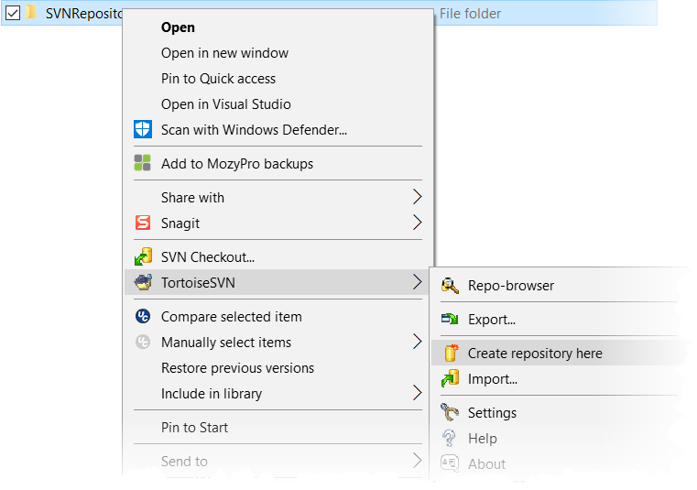
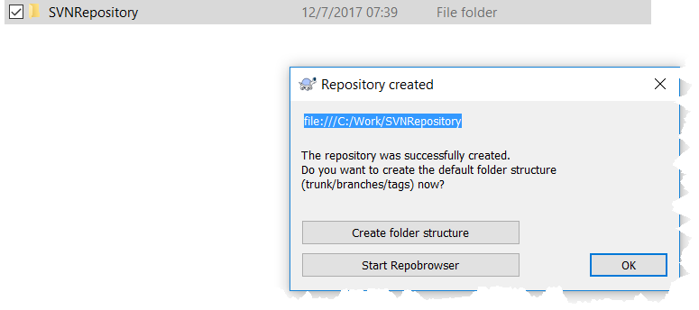
SET UP source control environment
In the next steps we will look at are setting up a software control environment
In this example we will use Tortoise SVN (https://tortoisesvn.net/)
After downloading we next create a directory from example SVNRepo
Using the right mouse action on the folder
we select Create Repository Here
Next Create File Structure
This creates a SVN Repo
which is normally a remote Server
for excess by the team
Notes:
The example uses Tortoise – GIT might be in use at customer or partner site. The process will be similar

Slide 52
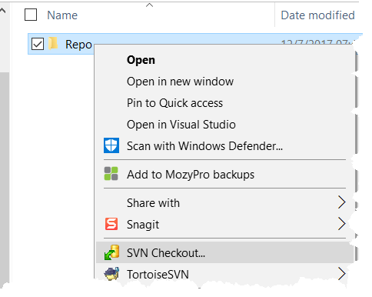
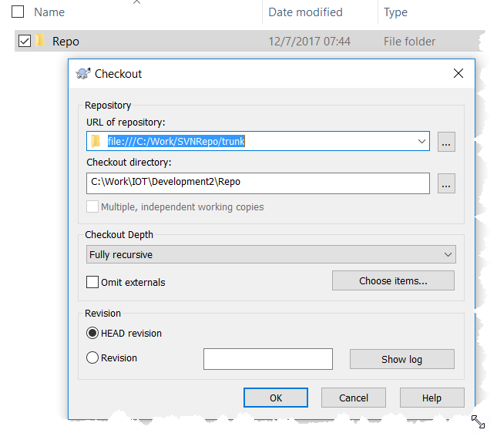
INITIALIZE THE SVN repo with source
From a clean system we will Export Source Control Entities from Thingworx
This will be the base for our Repo
Create another directory which will be your working location
For example C:\Work\IOT\Development\Repo
Right mouse on this directory
Select Checkout (the recently created Repo should be listed)
Select the trunk as the Checkout directory - Click ok
Unzip contents of source control into Repo folder
Notes:
The example shows setting up a repo and initializing it using a source control export. This will step up the folder structure for developers to check-in against

Slide 53
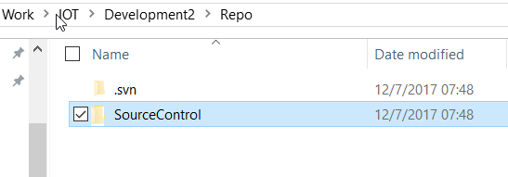
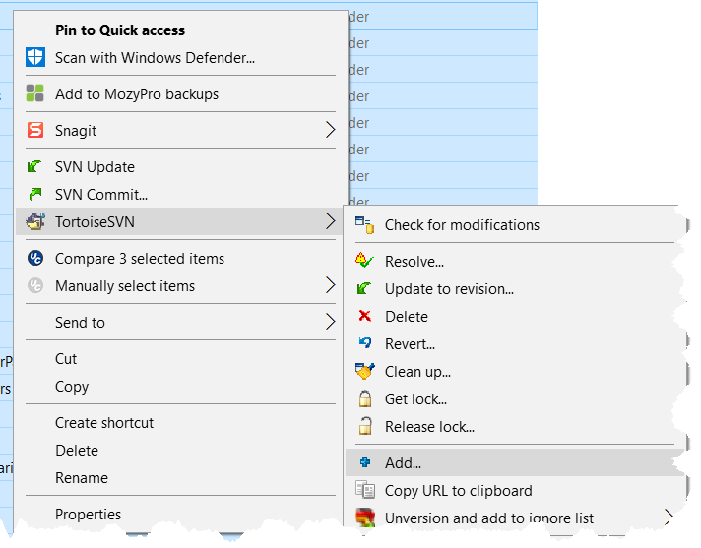
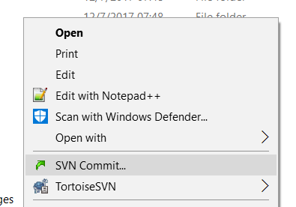
CHECKIN BASE
Navigate to the C:\Work\IOT\Development\Repo
Locate folder SourceControl
Right Mouse SVN Add
Select All
Press OK
Right Mouse SNV Commit
Add a comment Initial Base Commit
Press OK
Notes:
The sourcecontrol directory is being checked-in

Slide 54
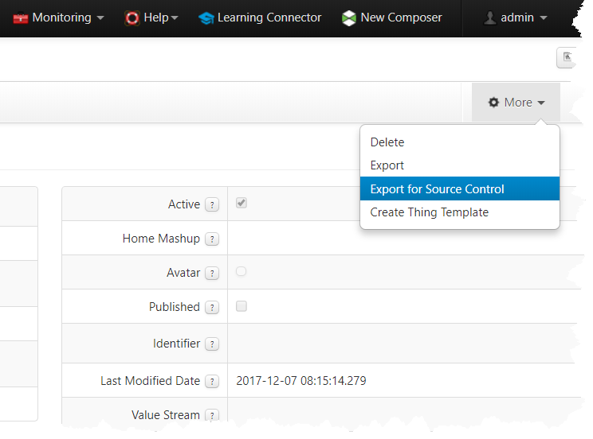
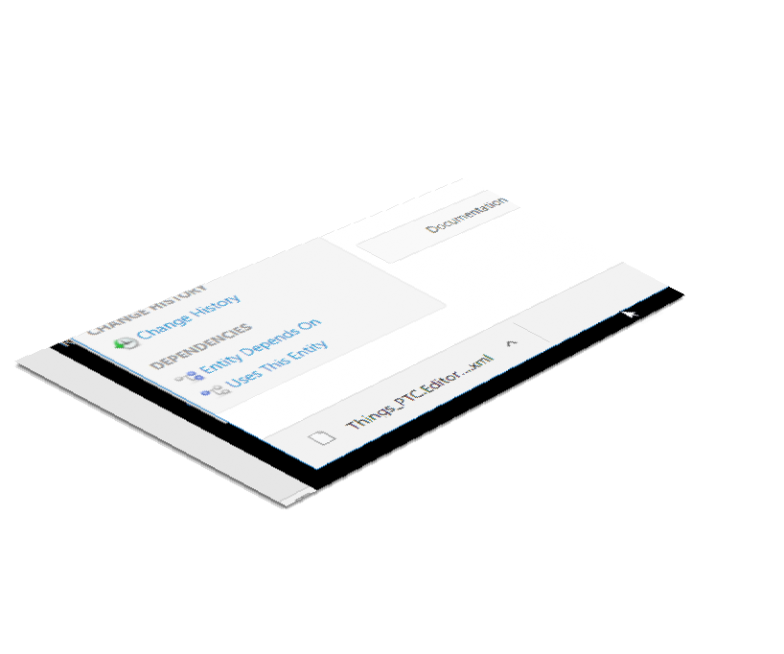
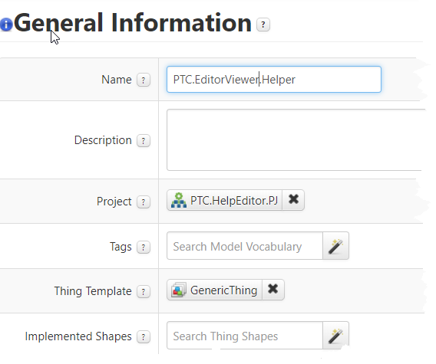
NOW WE CAN MAKE Changes to ENTITIES PART1
To test out the new Repo
Create a new Entity then Export - Source Control
This will create a file in your downloads folder
Notes:
Do some development and export entites

Slide 55
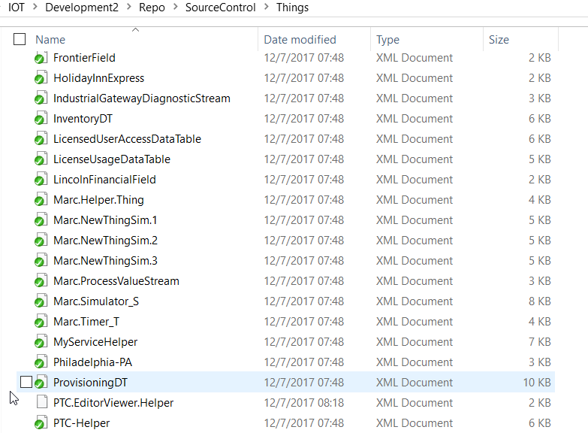
NOW WE CAN MAKE Changes to ENTITIES PART2
Locate and rename
For example
Things_PTC.EditorViewer.Helper.xml
will be
Move the file from downloads folder to correct folder
rename to
PTC.EditorViewer.Helper.xml
in this case as it’s a Thing it goes in the Things Folder
C:\Work\IOT\Development2\Repo\SourceControl\Things
Notes:
The names of the export need tweeking

Slide 56
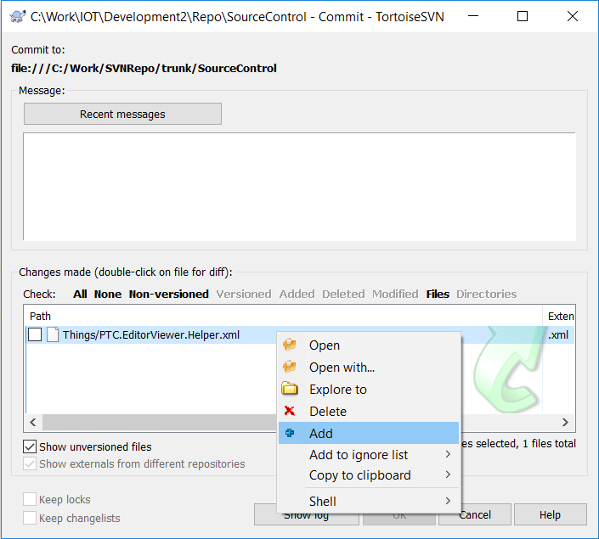
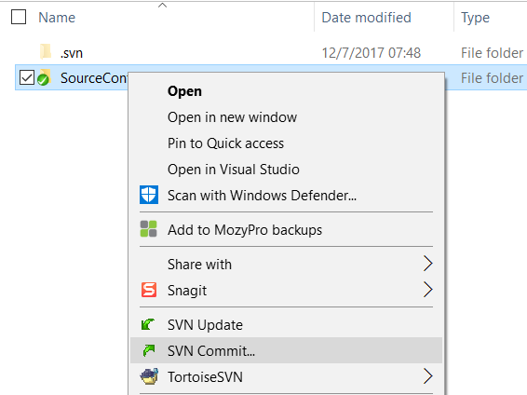
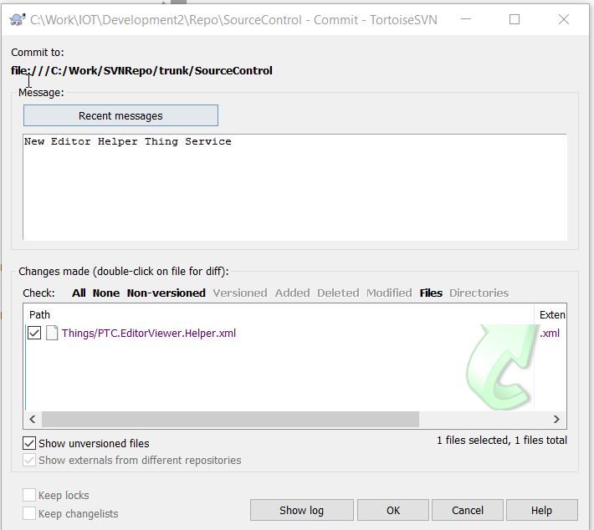
NOW WE CAN MAKE Changes to ENTITIES PART3
To commit any changes return to the Rep directory and Commit
enter comment

Slide 57
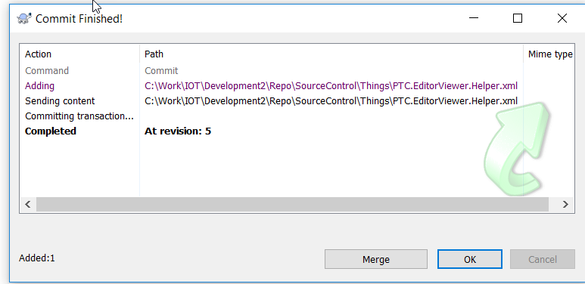
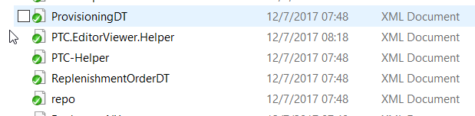
NOW WE CAN MAKE Changes to ENTITIES PART4
press OK to commit and the Entity is now under source control
Notes:
Checkin done

Slide 58
Deployment automation
Notes:
This slide deck is to help in the understanding of DevOps in relation to Thingworx Foundation platform
Jira link https://ssp.ptc.com/jira/browse/CSPORTDEV-1921

Slide 59
DEPLOYMENT AUTOMATION?
It would make sense to create a Mashup to help with Exports and Imports and getting Files from the Server-Side
Plus setting Collections and System permissions
Notes:
PTC does not have any supported Mashup process but there are a few examples. It would be up to the customer or partner to create there own.

Slide 60
Deployment flow diagram
Notes:
This slide deck is to help in the understanding of DevOps in relation to Thingworx Foundation platform
Jira link https://ssp.ptc.com/jira/browse/CSPORTDEV-1921

Slide 61
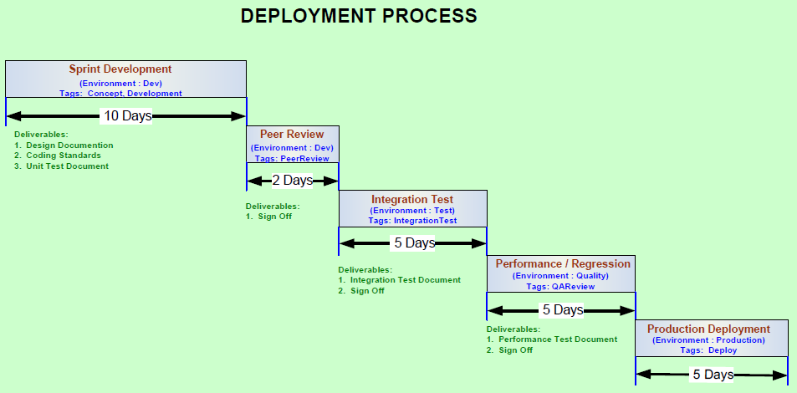
DEPLOYMENT PROCESS EXAMPLE
Notes:
Typical deployment process the customer or partner needs to define their process – It could be the same of different.

Slide 62
summary
Notes:
This slide deck is to help in the understanding of DevOps in relation to Thingworx Foundation platform
Jira link https://ssp.ptc.com/jira/browse/CSPORTDEV-1921

Slide 63
SUMMARY SO FAR
Development Strategy as a whole
Particular points
Environments
DEV, TEST, QA, PRODUCTION
Structure
Think Users, Groups and Organizations
Naming Conventions
Coding/Scripting Standards
Export / Import strategies
Acceptance criteria
Source Control
Code History
Deployment Automation
Deployment process
Notes:
The next steps would be setting up a Dev and Test environment and working with Team to establish a working model and document any changes to the defined process.

Slide 64

REFERENCES
https://www.iotu.com/

Slide 65
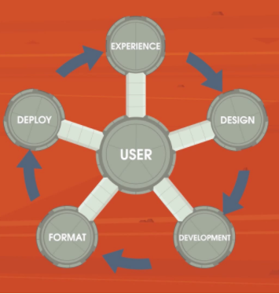
REFERENCES: ThingWorx UI Build Process

Slide 66
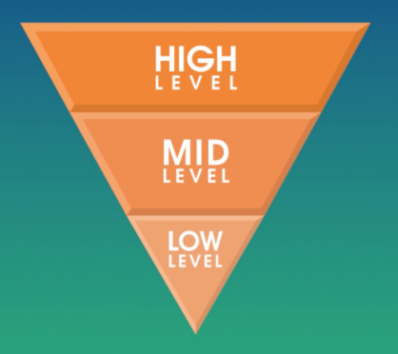
REFERENCES: Three Phases of Application Design

Slide 67
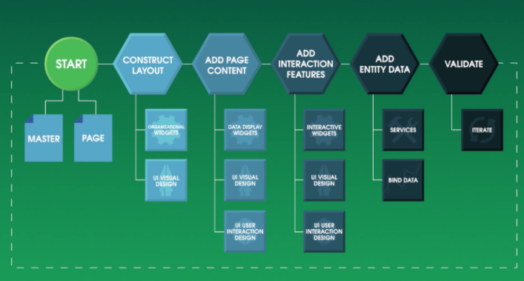
REFERENCES: Mashup Construction Cycle

